Slide 1
5CS024 – 7CC002 Worked Funnel Example

Slide 2
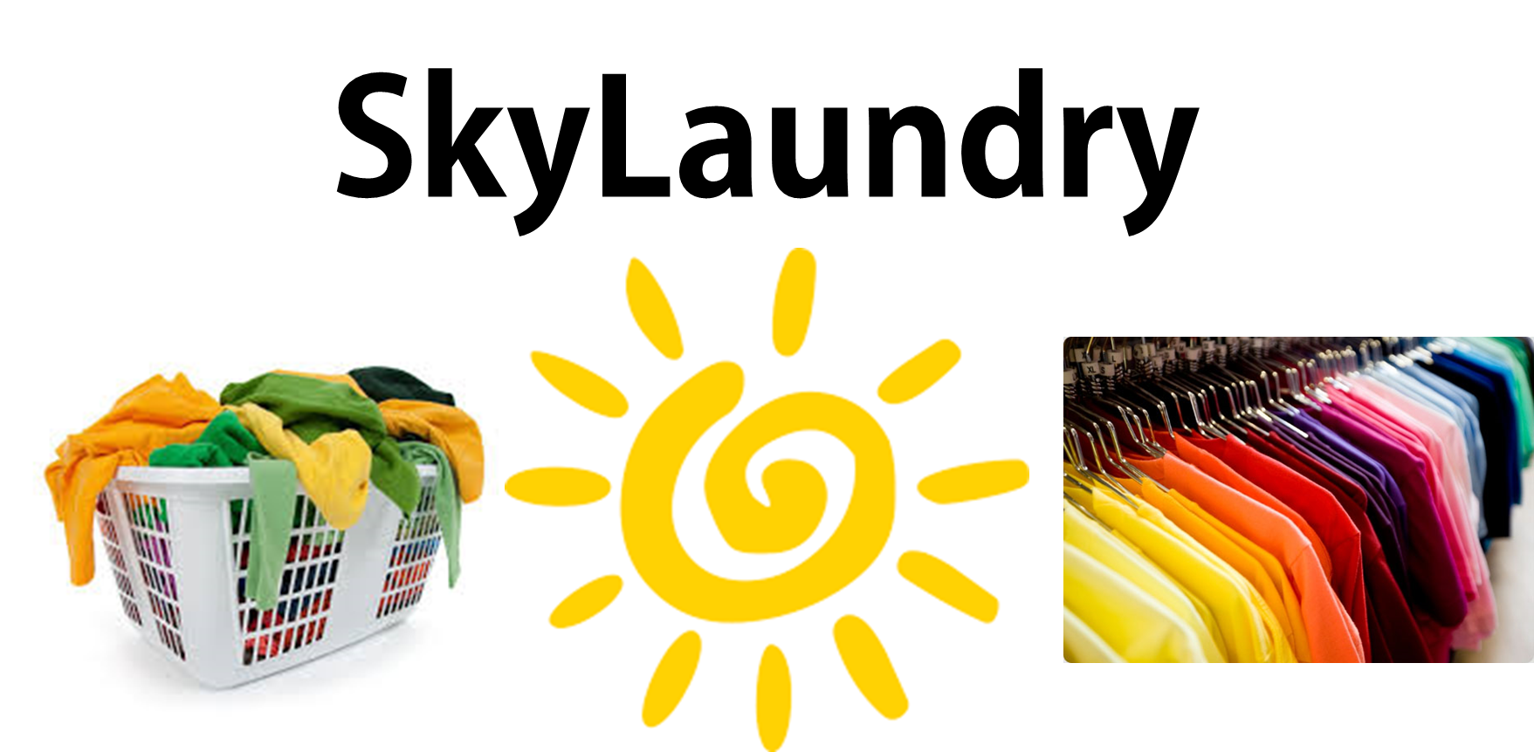

Slide 3
SkyLaundry
“Life’s too short for Laundry” so we created SkyLaundry to provide customers with a convenient, flexible and reliable way to have your clothes laundered.
SkyLaundry is a new Laundry-On-Demand service:
Customers want their clothes cleaned
They schedule their laundry to be collected
Drivers collect laundry and take it to the washers
When the laundry is ready they return it to the customers
Every month SkyLaundry bills the customers and pays the drivers

Slide 4



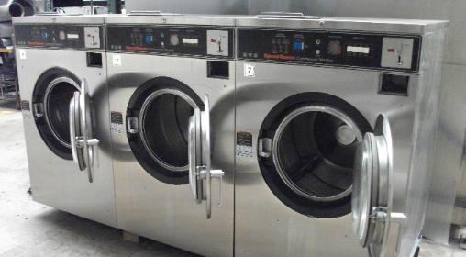
Customer no: 0032882
Laundry bags: 2
Ok
Order:008
Dispatch:008
Washers

Slide 5
Washers

Slide 6
Washers

Slide 7
Washing is processed in 24 Hours
Washers

Slide 8
Return:008
Washers

Slide 9
Washers

Slide 10
Delivered:008
Washers

Slide 11
Washers

Slide 12



Context Diagram
Our System
Users/Actors
Usecase

Slide 13
Context Diagram
SkyLaundry
Collection
Customer
Register
Process payments
Bank
Dispatch
Driver

Slide 14
Stakeholders

Slide 15
Laundry Workers
Customer
Deliver drivers

Slide 16
User Stories

Slide 17
Collect laundry
Manage payments
Register Customer
Register Driver
Driver Reports Fail
Cancel Order
Driver Reports Success

Slide 18
Team Tasks

Slide 19
SD,ED,DA,SA: Integration?
Register Customer
SD,ED: Basic build?
ED: App form capture
SD: Customer Capture form
SA: Secure data entry
DA: Customer Data Table

Slide 20
MVP Plan

Slide 21
A -SD,ED: Basic build (P1, 2 Days)
B - SD,ED,DA,SA: Integration
C-ED: App form capture (P1,1 Day)
D- SD: Customer Capture form (P1,1 Day)
E-DA: Customer Data Table (P2,2 Day)
F- SA: Secure data entry P3,2 Day

Slide 22
B
D
A
C
E
B
F

Slide 23
Questions

